Slide 1

PROJECT REVIEW
In The Subject Of
Software Development
Submitted by
Shital Bajirao Hiray
Seat no: 196
Under The Guidance of Dr. R.L. Pagar Sir
Year 2023-2024

Slide 2
Title of the project
“SHREE SIDDHIVINAYAK HOSPITAL APP”

Slide 3
Existing System
The existing system of hospital management at Shree Siddhivinayak Hospital is entirely manual. It involves traditional paper-based processes for patient registration, appointment scheduling, medical records management, inventory tracking, and billing. This manual approach is time-consuming, prone to errors, and lacks real-time data access, leading to inefficiencies in hospital operations. Moreover, there is a lack of centralized data management, making it challenging to retrieve patient information promptly and coordinate various departments effectively.

Slide 4
Proposed System
Proposed System: The proposed system aims to revolutionize hospital management by introducing a comprehensive Hospital Management System (HMS) application. This application will automate and streamline various hospital processes, enhancing efficiency, accuracy, and patient care. Key features of the proposed system include:
Patient Registration and Management: Enable patients to register online and manage their profiles, reducing paperwork and improving data accuracy.
Appointment Scheduling: Allow patients to book appointments with doctors conveniently through the mobile app, reducing waiting times and optimizing doctor's schedules.
Electronic Health Records (EHR): Digitize medical records to enable secure storage, easy retrieval, and sharing of patient information among healthcare providers.
Inventory Management: Automate inventory tracking for medicines, medical supplies, and equipment, ensuring adequate stock levels and minimizing shortages.
Billing and Payment: Generate electronic bills, enable online payment options, and streamline the billing process for patients and insurance companies.
Doctor-Patient Communication: Facilitate seamless communication between doctors and patients through secure messaging features, enabling remote consultations and follow-ups.
Reporting and Analytics: Provide administrators with real-time insights into hospital operations through customizable reports and analytics dashboards, enabling data-driven decision-making.
Integration with Third-Party Systems: Integrate with laboratory systems, pharmacy management systems, and insurance databases to ensure interoperability and exchange of information.

Slide 5
Need of the Project
Manual Processes: The hospital currently relies on manual methods for various tasks such as appointment scheduling, patient records management, and inventory tracking. This leads to inefficiencies, errors, and delays in service delivery.
Communication Challenges: Patients often face difficulties in accessing information about available services, doctors' availability, and appointment bookings. Likewise, staff members may struggle to communicate effectively with each other due to the lack of a centralized system.
Patient Convenience: In today's digital age, patients expect convenient and seamless experiences when interacting with healthcare facilities. An app can provide them with easy access to services, appointment bookings, health records, and educational resources from their mobile devices.
Streamlined Operations: Implementing a hospital management app can streamline various operational processes, including appointment scheduling, billing, inventory management, and communication among staff members. This can result in cost savings, improved resource utilization, and better overall efficiency.
Competitive Advantage: Offering a user-friendly and feature-rich mobile app can differentiate Shree Siddhivinayak Hospital from competitors in the healthcare industry. It demonstrates the hospital's commitment to innovation, patient-centric care, and leveraging technology to enhance healthcare delivery.

Slide 6
Scope of the Project
Appointment Management: Patients can schedule, reschedule, or cancel appointments with doctors or specialists through the app. The system should provide real-time availability of doctors and allow users to select their preferred time slots.
Patient Registration and Profile Management: The app facilitates patient registration by capturing essential details such as personal information, medical history, and insurance details. Patients can also update their profiles and view their appointment history.
Doctor Directory: A comprehensive directory of doctors and specialists available at Shree Siddhivinayak Hospital, along with their profiles, qualifications, areas of expertise, and availability schedules.
Health Services Information: Detailed information about the various healthcare services offered by the hospital, including diagnostic tests, medical procedures, treatment options, and specialty services.
Health Records Access: Patients can securely access their health records, including medical reports, prescriptions, treatment history, and diagnostic images, through the app. The system should ensure compliance with data privacy regulations and encryption standards.
Medicine and Pharmacy Services: Integration with the hospital's pharmacy system to allow patients to order prescription refills, purchase over-the-counter medications, and receive alerts for medication reminders.
Health Education and Resources: The app provides educational resources, health tips, articles, and videos on wellness, disease prevention, and lifestyle management. Users can access reliable healthcare information and stay informed about various medical conditions.
Emergency Assistance: Quick access to emergency services, including ambulance requests, emergency contacts, and navigation to the nearest emergency department or healthcare facility.
Feedback and Support: Patients can provide feedback on their experience with the hospital services, submit inquiries or complaints, and seek assistance from customer support representatives through the app.
Administrative Features: Administrative functionalities for hospital staff, including managing appointment schedules, patient records, billing and payments, inventory management, and generating reports for performance analysis and decision-making.
Integration with Existing Systems: Seamless integration with the hospital's existing electronic health record (EHR) system, laboratory information system (LIS), billing system, and other relevant healthcare IT systems for data exchange and interoperability.

Slide 7
Objectives of the Project
1. **Enhanced Accessibility:** Make it easy for users to access important healthcare services from anywhere, breaking down geographical barriers.
2. **Optimized Healthcare Delivery:** Improve hospital operations by reducing wait times and making interactions smoother, leading to happier patients.
3. **Empowered Decision-Making:** Provide hospital administrators with detailed information and analytics to help them make better decisions about resources and quality improvements.

Slide 8
Requirement Analysis
Hardware Requirements:
1) Processor: Dual Core or latest
2) RAM: Minimum 8 GB
3) Hard Disk: Minimum 512 GB
Software Requirements:
1) Operating system: Windows 7 or latest
2) Front End: XML
3) Back End: Java
4) Database: MySQL
5) Editor: Android Studio
Server Requirements:
1) Server: MySQL database

Slide 9
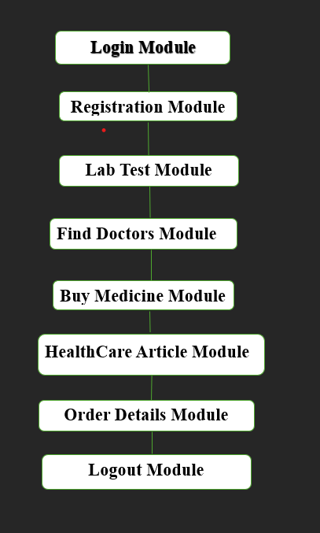
Diagrams
Project Modules Diagram:

Slide 10
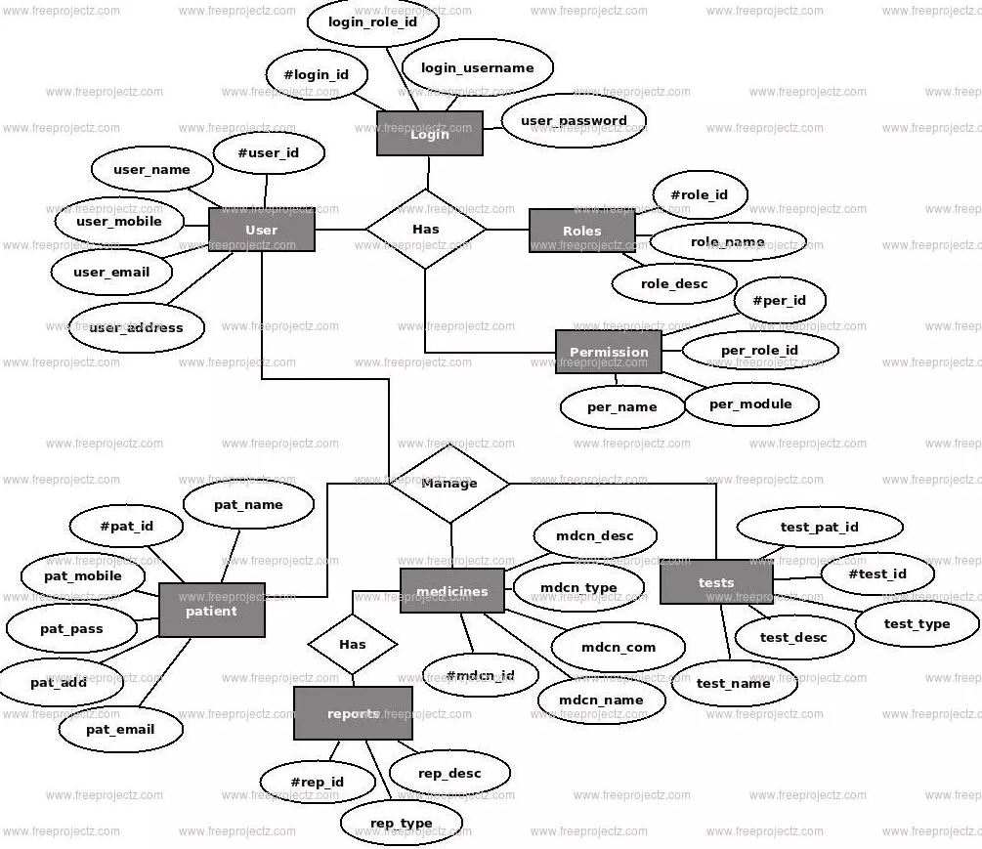
ER Diagram:

Slide 11
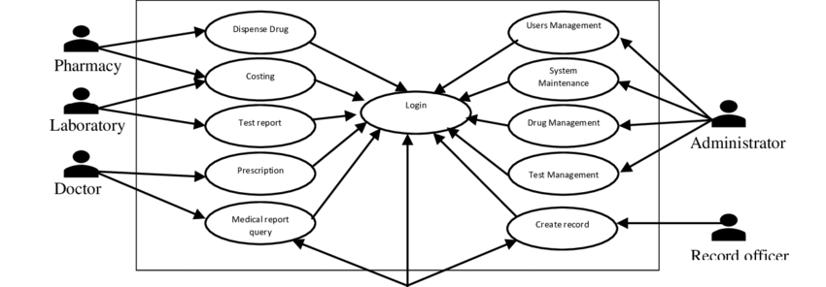
Use Case Diagram:

Slide 12
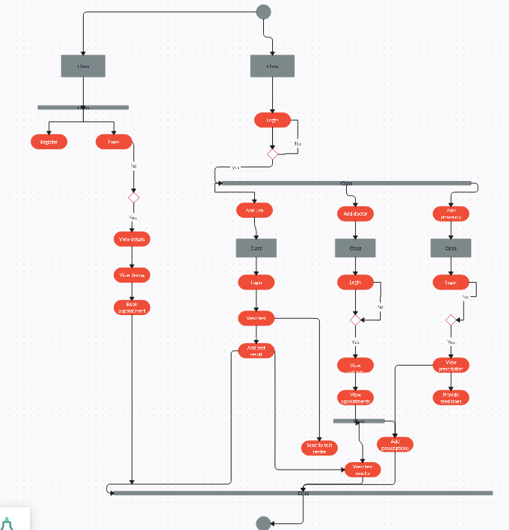
Activity Diagram:

Slide 13
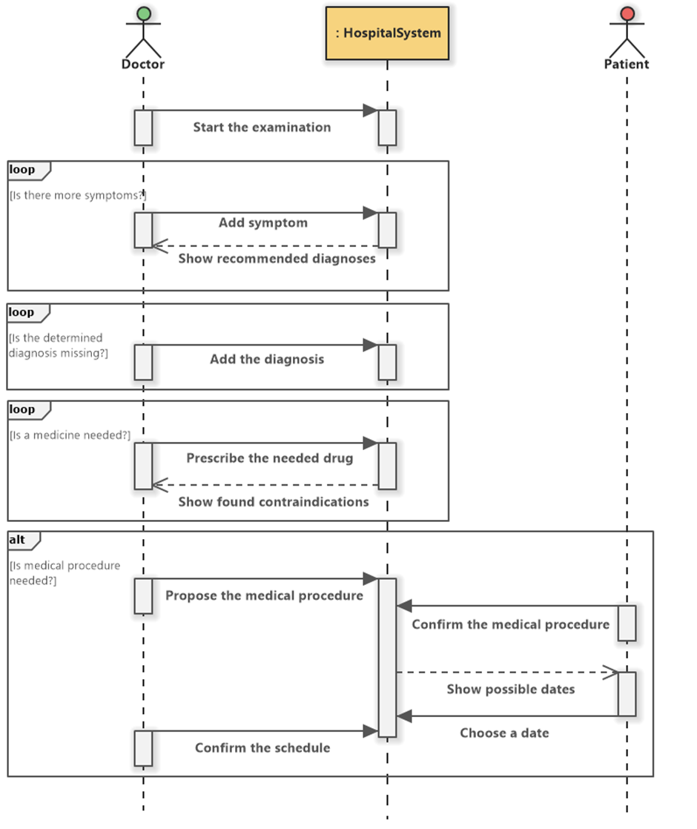
Sequence Diagram:

Slide 14
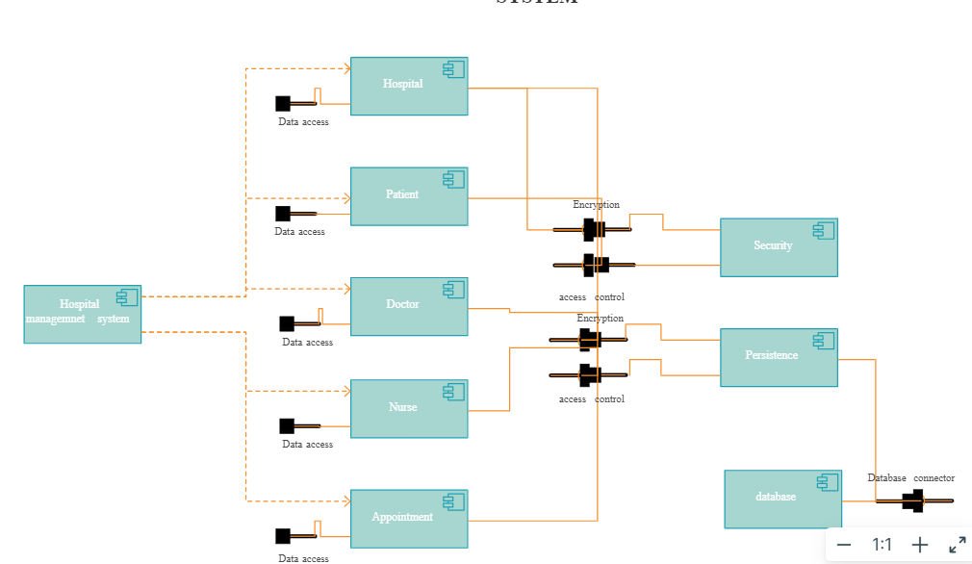
Component Diagram:

Slide 15
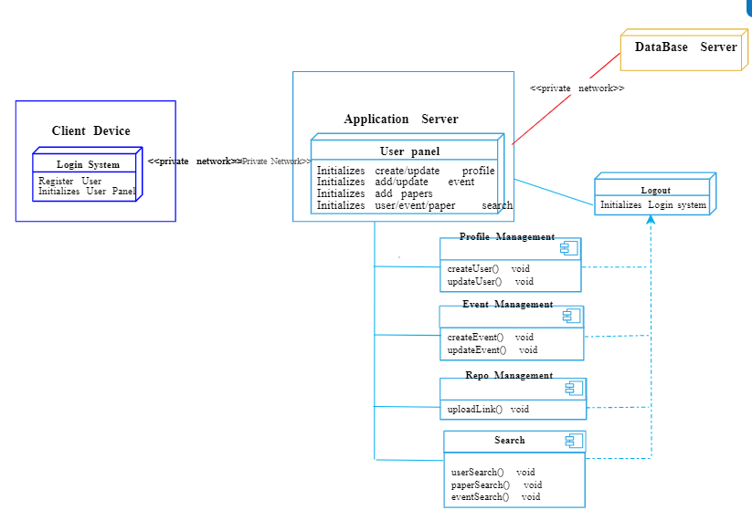
Deployment Diagram:

Slide 16
Database Design(Table)
Field | Data Type | Description
User_ID | INTEGER | Unique identifier for each user
Username | TEXT | Username for user authentication
Password | TEXT | Password for user authentication
Table Name: User

Slide 17

Interface Design(I/O Screens)
Front page:

Slide 18
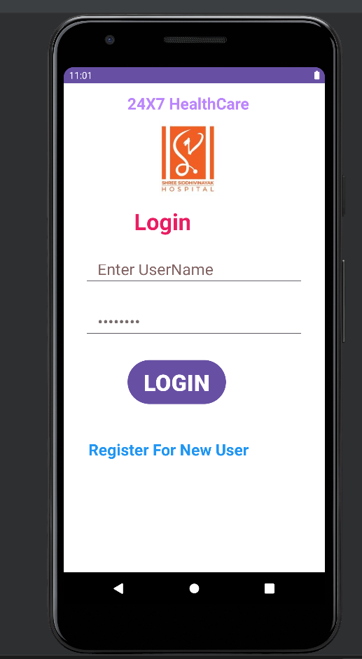
Login Page:

Slide 19
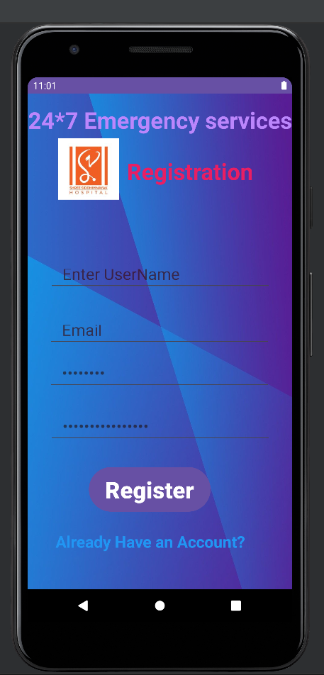
Registration Page:

Slide 20
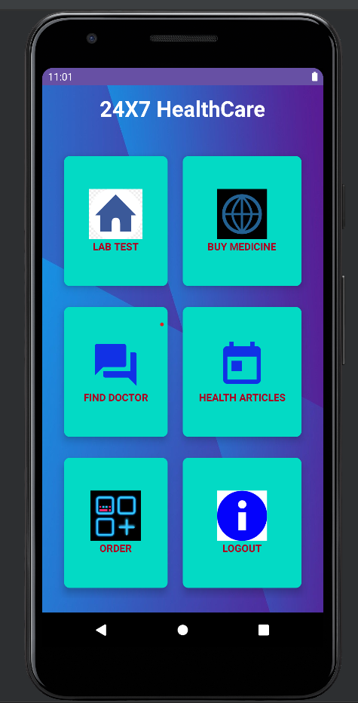
Home Page:

Slide 21
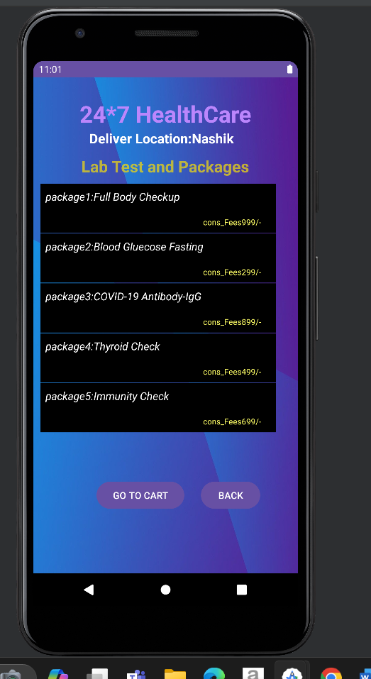
Lab Test Page

Slide 22
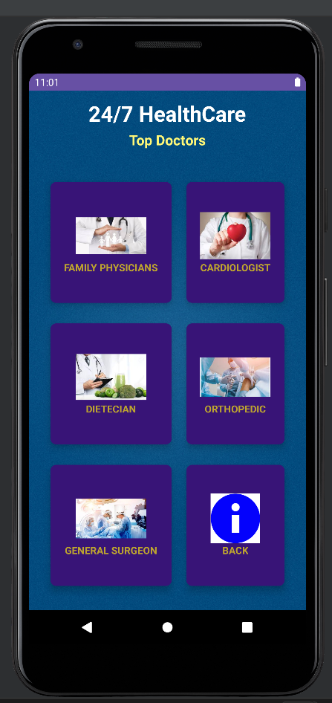
Find Doctor Page

Slide 23
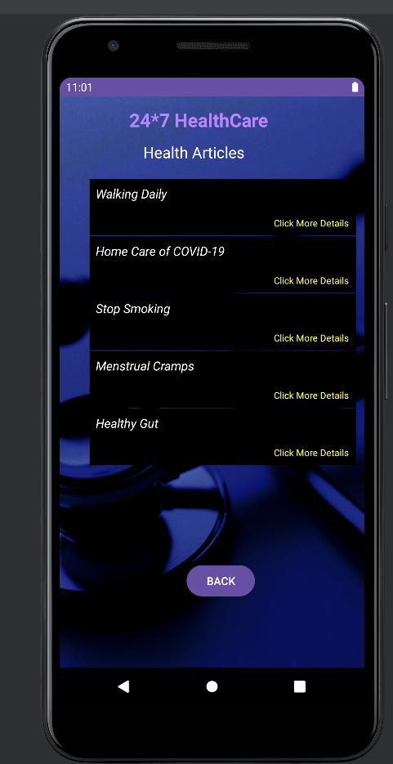
Health Articles

Slide 24
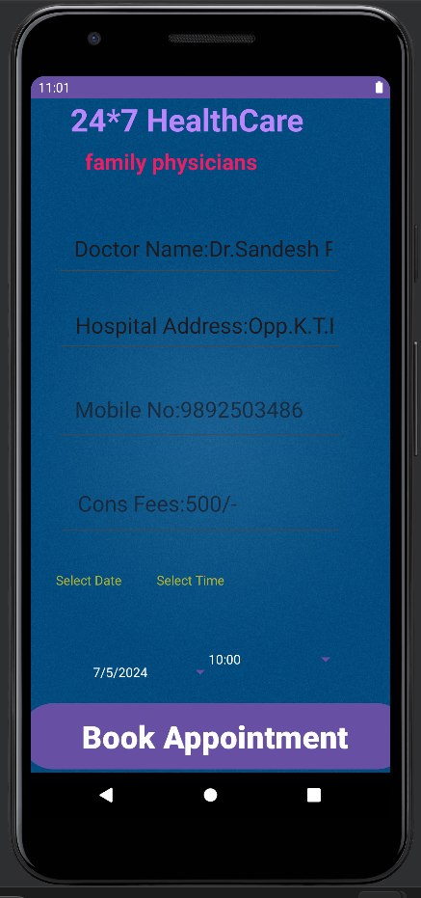
Report Generation
Appointment Booking Page

Slide 25
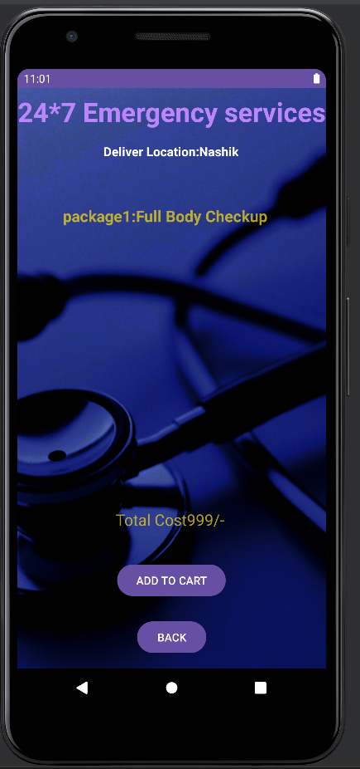
Lab Page Details

Slide 26
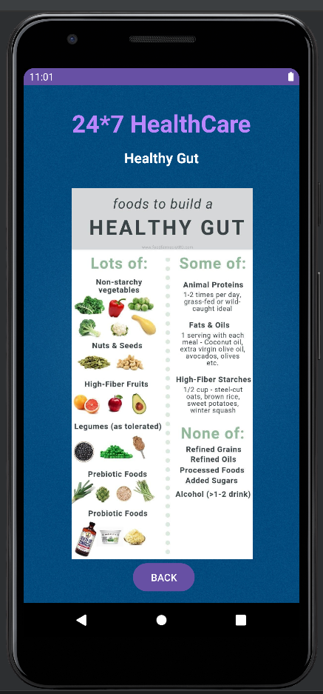
Health Articles Details

Slide 27
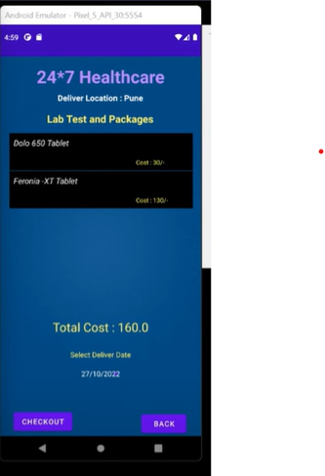
Order Details Page

Slide 28
Conclusion
1.Positive Aspects:
Enhanced Efficiency: The Shree Siddhivinayak Hospital Android application significantly improves operational efficiency by automating various processes such as appointment scheduling, order management, and information dissemination.
Informed Decision-Making: Through comprehensive data analytics and reporting features, the application empowers hospital administrators and staff to make data-driven decisions, leading to improved resource allocation and service delivery.
Enhanced Patient Experience: With functionalities like online appointment booking and access to health articles, the application enhances the overall patient experience by providing convenience and valuable information.
Robust Support System: The inclusion of features such as help desk services and user guides ensures that users can easily navigate the application and receive prompt assistance when needed, contributing to high user satisfaction.
Scalability: The modular architecture of the application allows for seamless scalability, enabling the hospital to adapt and grow in response to changing requirements and increasing patient demand.
2.Negative Aspects:
Initial Implementation Challenges: The initial deployment and configuration of the application may pose challenges, particularly for hospitals with limited technical expertise or resources, requiring careful planning and investment.
Training Requirements: Hospital staff may require comprehensive training to fully utilize the features and functionalities of the application, which could entail additional costs and time commitments during the implementation phase.

Slide 29
Suggestions
User Experience Enhancement:
Continuously gather user feedback for interface improvements.
Optimize for mobile devices and ensure responsiveness.
Integration and Innovation:
Explore integrating with wearable health devices.
Incorporate telemedicine features for virtual consultations.
Data Analytics and Security:
Implement advanced analytics for insights.
Strengthen security measures for data protection.
Automated Processes:
Set up automated appointment reminders.
Introduce a feedback mechanism for patient insights.
Continuous Improvement:
Regularly update and refine based on user needs.
Prioritize features that enhance efficiency and patient care.

Slide 30
Bibliography:
Books:
""Hospital Management Handbook" by Dr. Rahul Shinde.
"Financial Management in Healthcare" by Dr. Rajesh Deshmukh.
Workshops:
Workshop on Healthcare Management conducted by Dr. Sandesh Patil, Shree Siddhivinayak Hospital.
Seminar on Patient Care Strategies led by Dr. Sandesh Patil, Shree Siddhivinayak Hospital.
Websites:
https://www.healthcaremanagement.com/blog/hospital-management-systems
https://www.who.int/health-topics/hospital-management
https://www.ncbi.nlm.nih.gov/pmc/articles/PMC5291593/
https://www.hindawi.com/journals/ahci/2020/8827923/

